Slide 2
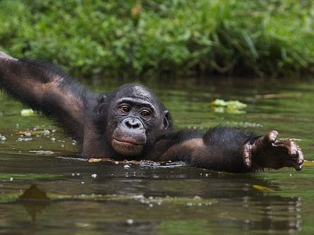
Aquatic Apes?
Why do we look like us?
Science 20 (Evolution)
Biology 20 (Evolution)
Biology 30 (Evolution)

Slide 3
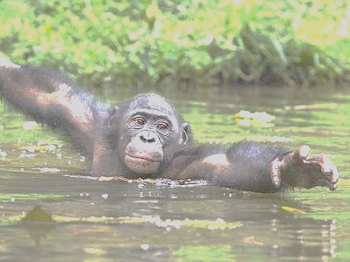
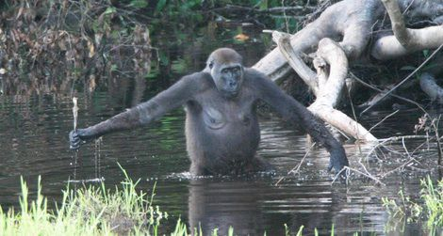
Notes:
Standing upright to make it easier to move around in the water.

Slide 4
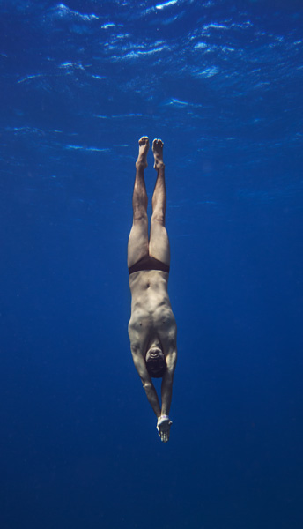
Notes:
Diving abilities: ability to override autonomic nervous system and hold breath.

Slide 5
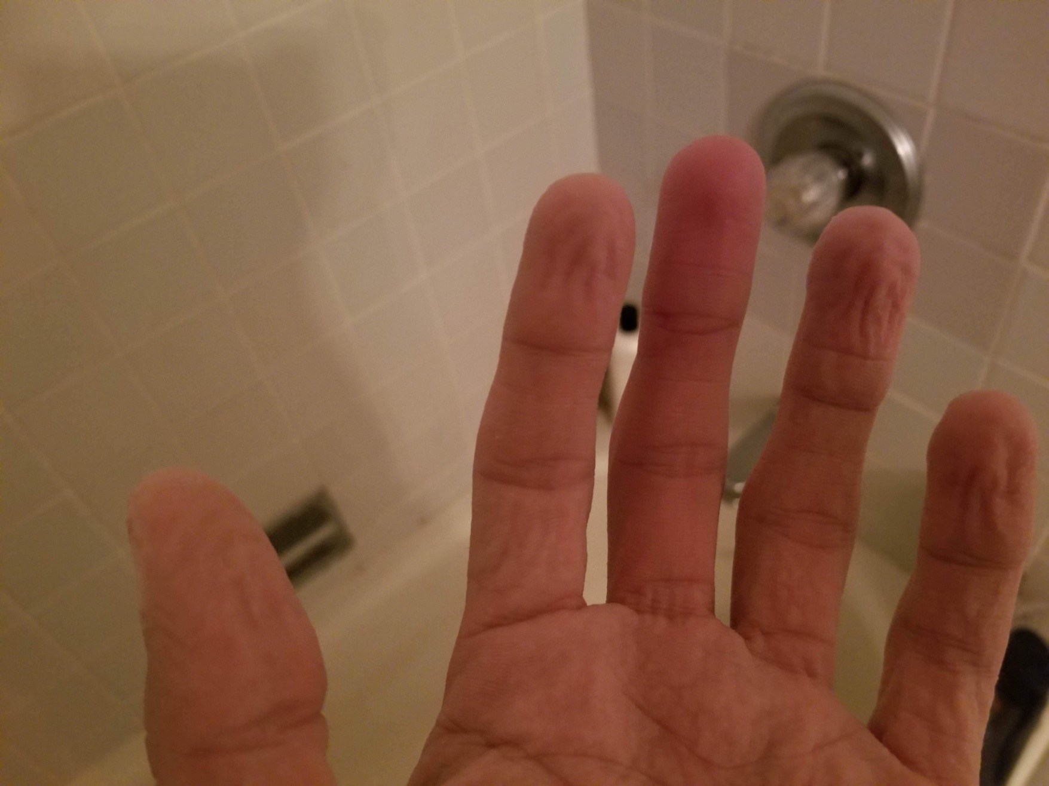
Notes:
Pruny fingers to improve grip

