Slide 2
Nodes at Night
Physics 20 Unit D
Notes:
References:
The Wizard War R.V. Jones
https://en.wikipedia.org/wiki/Battle_of_the_Beams

Slide 3
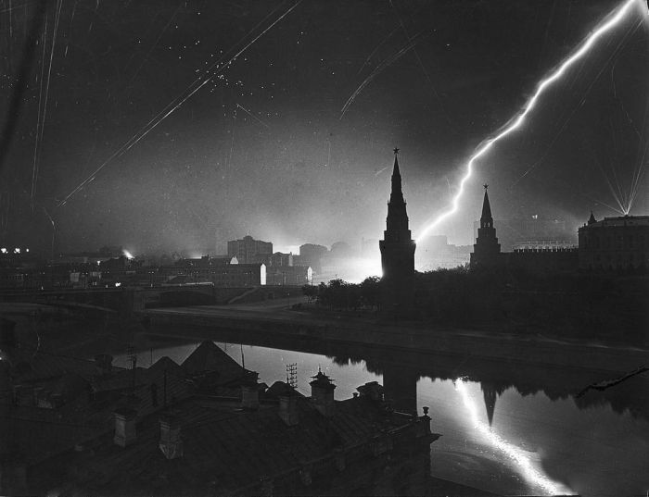
Notes:
By the beginning of WWII, aircraft technology had developed to the point where bombers could carry heavy payloads long distances. They were, however, easy pickings for anti-aircraft guns and fighters. The allies and the axis both realized that the solution was to wait until night, paint your bomber black, and drop your bombs at night. The only problem was finding your targets.

Slide 4
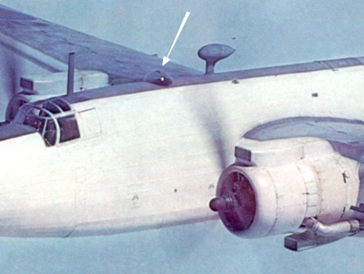
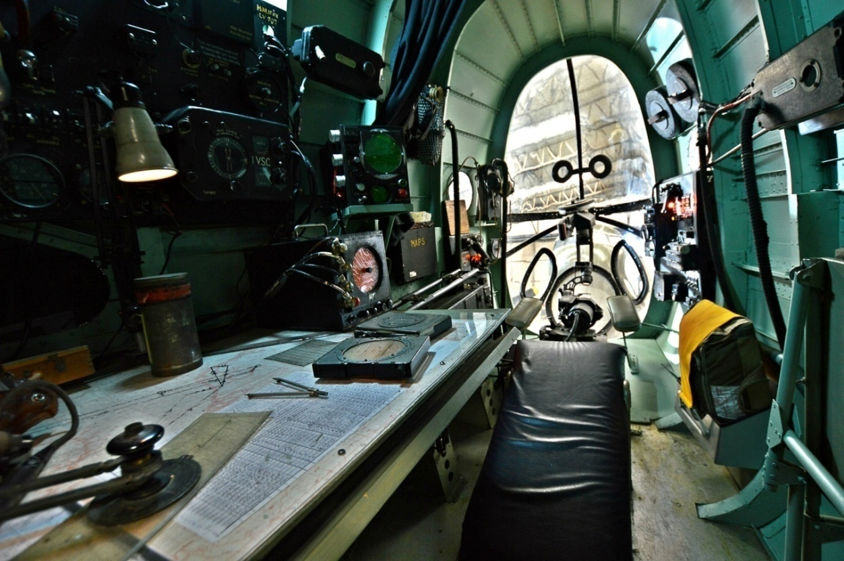
Notes:
The British solution was to give the navigator an illuminated workstation and an astrodome for taking a ‘star fix’ and doing celestial navigation. As you might expect, it didn’t work very well. You might expect to hit the right city, if it was a big one. The German Luftwaffe was not satisfied with this, and put their energy into radio navigation systems.

Slide 5
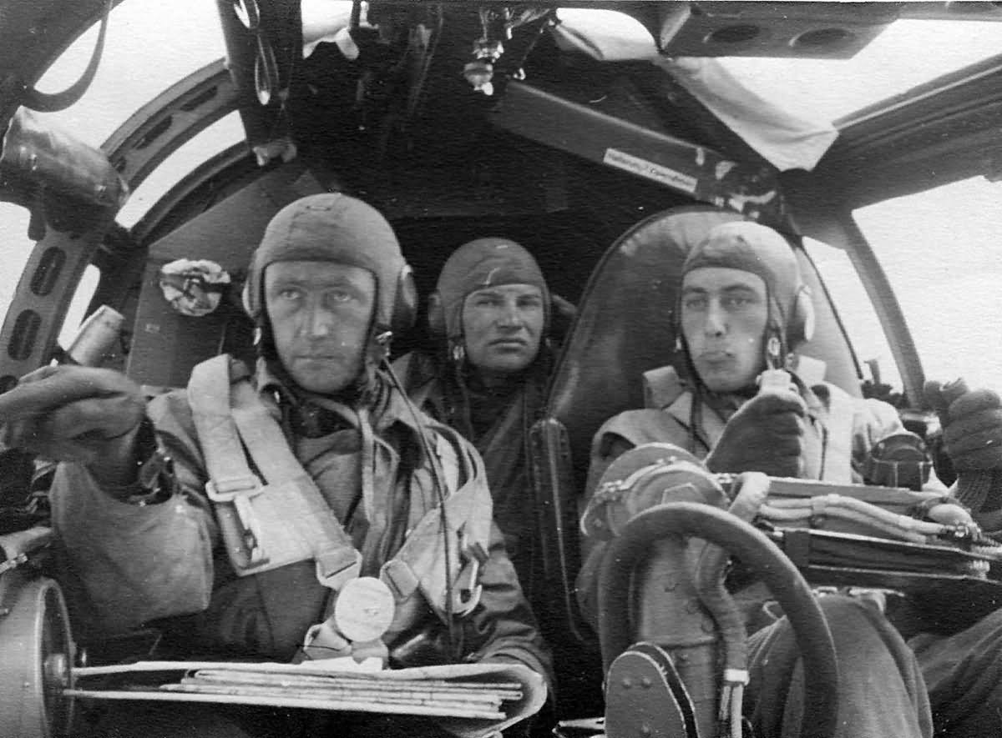
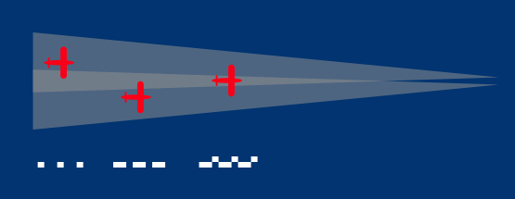
Notes:
The first German system used a “Lorenz beam”, which was originally designed as a landing aid. A modulated radio signal is oscillated back and forth between two antennas. If you’re to the left of the runway you hear only one tone, to the right you hear another. Right in the middle you hear both.

Slide 6
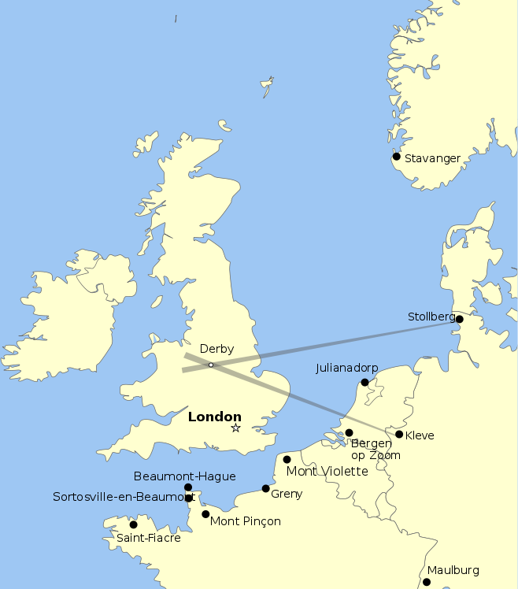
Notes:
German bomber command decided this could be used to guide bombers towards a target as well, with much more powerful transmitters (radios could already pick up the frequencies). But it could only be used to guide in a direction, not to signal when to drop bombs. To solve this problem, a second transmitter was directed to cross the first at the target. When the tone from the second receiver was heard, they dropped their bombs.

Slide 7
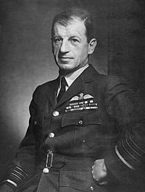
Notes:
The British Air Ministry, led by R. V Jones eventually found these beams using an amateur radio bought at a London hobby shop. They flew around until they discovered both beams and traced them to their cross above the Rolls Royce factory (manufacturing the Merlin aircraft engine). Instead of jamming these signals, Jones started broadcasting dummy signals causing bombers to veer off course and drop their bombs in the wrong place. Since Luftwaffe crews were trained to navigate solely by the signals, some could not find the true signals back (and therefore Germany), some bombers even landed at RAF bases, believing they were back in Germany.

Slide 8
Notes:
Eventually a new system was introduced, and Jones started to hear about it in the coded Enigma traffic. The codename was Wotan, which they realized referred to a one-eyed germanic god. Jones started to speculate about a new system which only made use of a single beam.

Slide 9
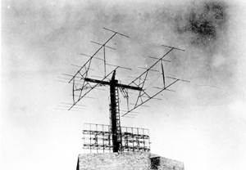
Notes:
The new system used a narrow beam pointed over the target, but the ranging was different. A new piece of equipment recieved the signal from the beam and immediately re-transmitted it back to the ground station. The ground station would listen for the return signal and compare the phase of its modulation to the transmitted signal. This gave an accurate measure of transit time, from which distance could be calculated. Instructions for dropping bombs were then given via radio.
What I thought the Nazis did...

