Slide 1
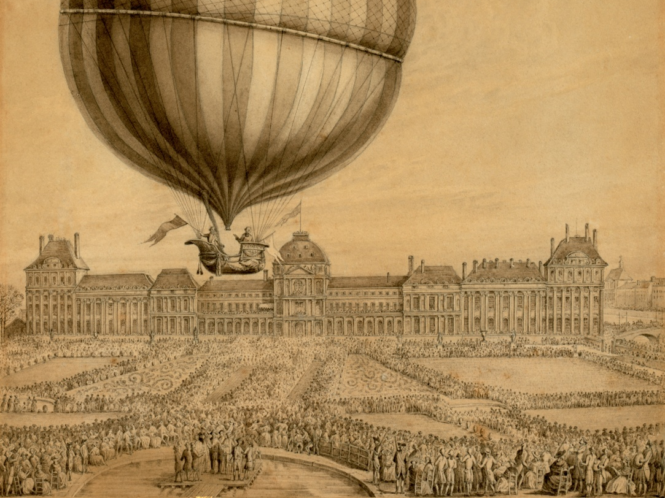
More than hot air
Chemistry 20, Unit B (Gases)
Chemistry 20, Unit D (Stoich)
Jaques Charles
Notes:
References:
https://en.wikipedia.org/wiki/History_of_ballooning
“Eccentric France: the Bradg Guide to Mad, Magical, and Marvellous France” Piers Letcher

Slide 2
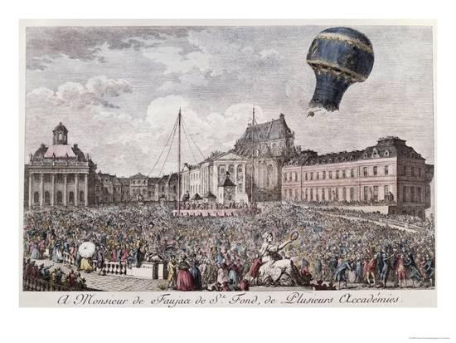
Montgolfier Bros.
Notes:
Montgolfier brothers perform first hot air baloon flight in 1783. Louis 16th wanted criminals to be the first pilots, but de Rozier (scientist) petitioned for the honour.

Slide 3
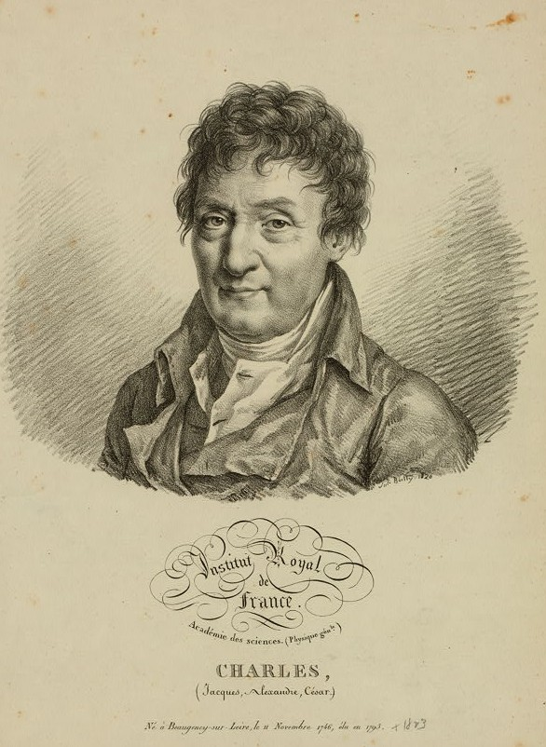
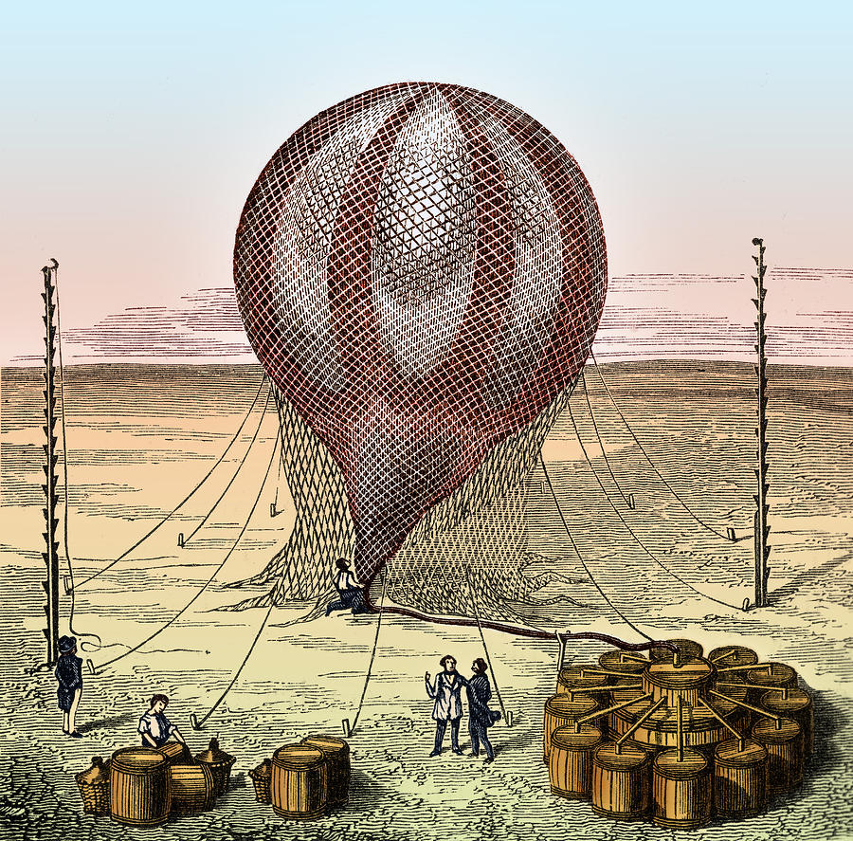
Jaques Charles
H₂SO₄ + Fe
Notes:
Enter Charles: realizes that Hydrogen is lighter than air – this will work too. A 35000 L silk balloon is filled by dumping a quarter tonne sulfuric acid onto half a tonne of scrap iron. Lead pipes were used to feed the hydrogen into the balloon.

Slide 4
STOICH BREAK: Charles produced 35000 L of hydrogen gas (at SATP) by dumping sulfuric acid onto scrap iron.
What mass of iron does he need to collect?
If his sulfuric acid has a concentration of 14 mol/L, what volume is required? Or, set it up as a limiting/excess problem.
Notes:
Enter Charles: realizes that Hydrogen is lighter than air – this will work too. A 35000 L silk balloon is filled by dumping a quarter tonne sulfuric acid onto half a tonne of scrap iron. Lead pipes were used to feed the hydrogen into the balloon.

Slide 5
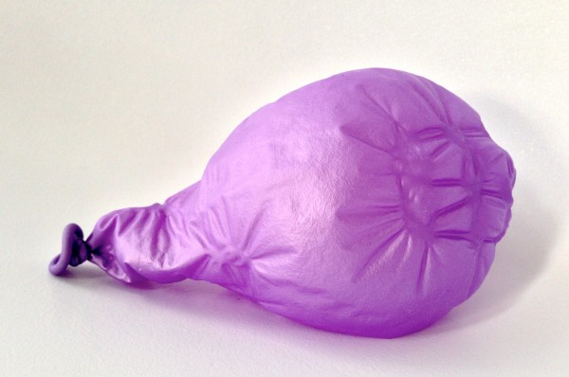
Charles’ Problem:
Charles’ Problem:
Notes:
Charles’ Problem the warm hydrogen cooled. Daily progress bulletins were issued...

Slide 6
A Charles’ Problem Charles’ Law Problem:
Charles had difficulty filling his balloon. The 35000 L of hydrogen was injected at 200°C but quickly cooled to ambient temperature (20°C).
What volume would the cooled gas occupy?

Slide 7
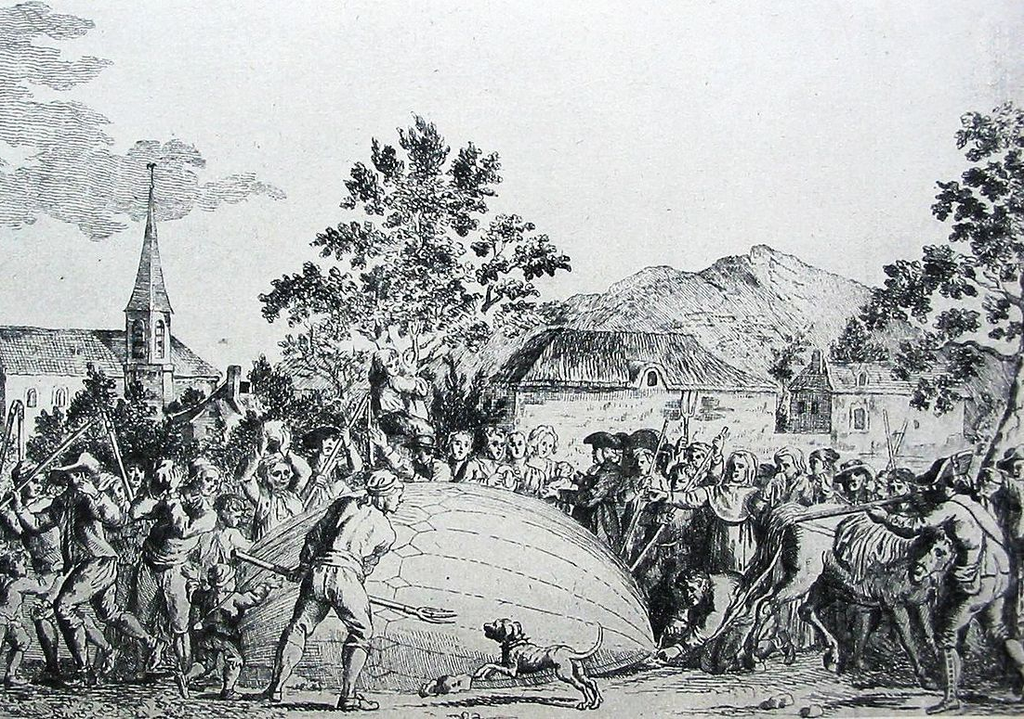
Notes:
Finally the balloon is filled and launched from Paris. It flies 21 km north in 45 minutes, chased by riders on horseback. It lands in the village of Gonesse, where it is quickly destroyed by terrified villagers.

