Slide 1
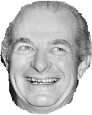
Science 30 Unit A (Living Systems)
Biology 30 Unit C (Genetics)
Even the Beyonces
Get it Wrong
(Sometimes)
Notes:
AUDIO – Maurice Wilkins

Slide 2
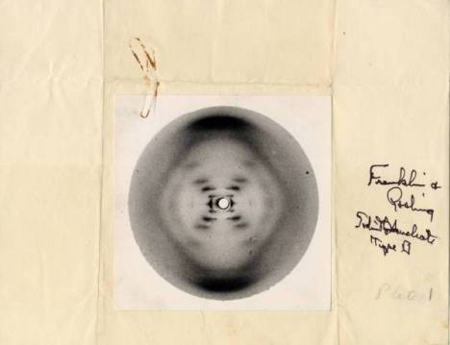
Notes:
Photo 51 – which Rosalind Franklin

Slide 3
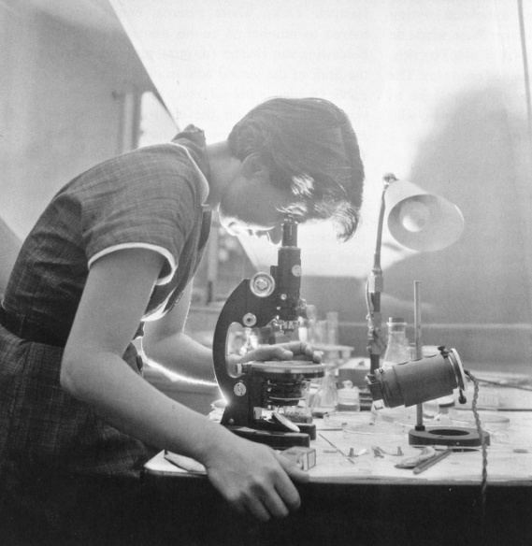
Notes:
Photo 51 – Rosalind Franklin and Maurice Wilkins were interested in DNA, Watson and Crick get

Slide 4
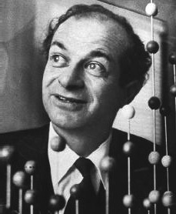
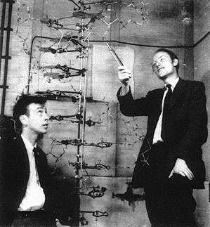
Everybody Loves an Underdog:
vs.
Notes:
James Watson – How we discovered DNA (TED Talk). Start: 16.05 left End: 11:16 left
RM: Watson and Crick vs. Linus Pauling: The importance of model building. When I teach about the structure of DNA in Bio 30 I don’t start with Watson and Crick, or even Rosalind Frankiln. I like to start by talking about a chemist: Linus Pauling.
Pauling was a master of the model. He had used a model-building problem-solving approach to unlock the structure of the alpha helix and the beta sheet (protein secondary structures). He was doing exceptional work which would lead to a nobel prize in 1954. Everything he touched seemed to turn into gold. I used to call him the “George Clooney” of post-war chemistry, but it turns out that high school students don’t know who that is anymore, so I now go with “Beyonce”. He tries to apply the same model-building approach that worked for him before – ending up with a triple helix. He didn’t use Chargaff’s data, he didn’t look at Franklin’s excellent x-ray photos. He got it wrong.
This allows for Crick and a baby-faced Watson to swoop in, their model explains Chargaff’s data (complementary base pairing), and is supported by Franklin’s work, includes a mechanism for replication. Done!
Pauling isn’t part of the curriculum, but a helpful example of a time when a renowned scientist gets it wrong, when

Slide 5
Everybody Loves an Underdog:
Notes:
James Watson – How we discovered DNA (TED Talk). Start: 16.05 left End: 11:16 left
RM: Watson and Crick vs. Linus Pauling: The importance of model building. When I teach about the structure of DNA in Bio 30 I don’t start with Watson and Crick, or even Rosalind Frankiln. I like to start by talking about a chemist: Linus Pauling.
Pauling was a master of the model. He had used a model-building problem-solving approach to unlock the structure of the alpha helix and the beta sheet (protein secondary structures). He was doing exceptional work which would lead to a nobel prize in 1954. Everything he touched seemed to turn into gold. I used to call him the “George Clooney” of post-war chemistry, but it turns out that high school students don’t know who that is anymore, so I now go with “Beyonce”. He tries to apply the same model-building approach that worked for him before – ending up with a triple helix. He didn’t use Chargaff’s data, he didn’t look at Franklin’s excellent x-ray photos. He got it wrong.
This allows for Crick and a baby-faced Watson to swoop in, their model explains Chargaff’s data (complementary base pairing), and is supported by Franklin’s work, includes a mechanism for replication. Done!
Pauling isn’t part of the curriculum, but a helpful example of a time when a renowned scientist gets it wrong, when

Slide 6
Everybody Loves an Underdog:
vs.
“And then there's Linus Pauling. Linus' fame had gotten himself into a position where everyone was afraid to disagree with him. The only person he could freely talk to was his wife, who reinforced his ego, which isn't what you need in this life.”
James Watson, "Succeeding in Science: Some Rules of Thumb", Science, 261, 24 (September 1993)

Slide 7
Even the Beyonces
The best and brightest don’t always get it right.
Even the world’s only recipient of 2 undivided Nobel prizes
vs.
“And then there's Linus Pauling. Linus' fame had gotten himself into a position where everyone was afraid to disagree with him. The only person he could freely talk to was his wife, who reinforced his ego, which isn't what you need in this life.”
James Watson, "Succeeding in Science: Some Rules of Thumb", Science, 261, 24 (September 1993)

