Slide 1
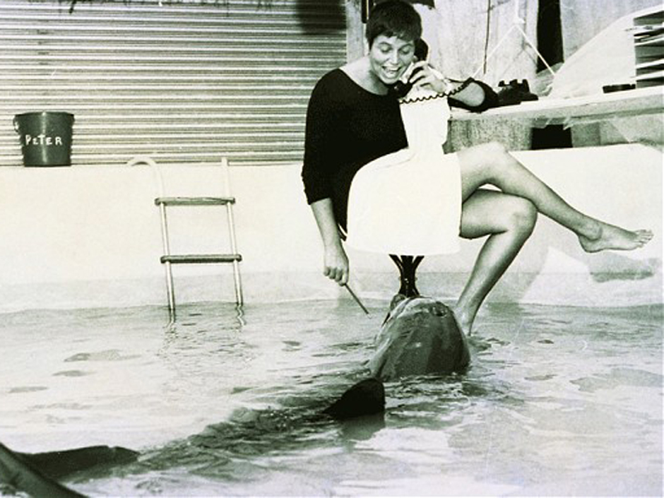
Margaret Howe Hot for Teacher
Biology 30 Unit A (Nervous System)
Psychology
There’s always time for a zany story
Notes:
This story was the impetus for this talk. Story about psychology teacher asking about nervous system. Me asking “did you ever hear the story about the dolphin…”? No. And her saying “that story is gross and pretty inappropriate” and then running into her a week later and her saying – yeah, so I told that gross inappropriate story to my students.
References:
http://www.dailymail.co.uk/sciencetech/article-2653422/The-woman-taught-dolphin-speak-fallen-love-her.html
https://www.theguardian.com/environment/2014/jun/08/the-dolphin-who-loved-me
BBC Doc The Girl Who Talked To Dolphins

Slide 2
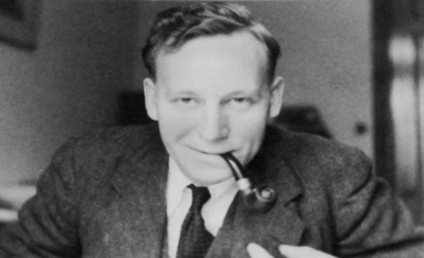
Notes:
Margaret Howe grew up on St. Thomas in the Caribbean. In the early 60s she met a tall man with tousled hair, wearing an open shirt and smoking a cigarette. His name was Gregory Bateson, a great intellectual of the 20th century and the director of a research lab. "Why did you come here?" he asked Howe. "Well, I heard you had dolphins," she replied, "and I thought I'd come and see if there was anything I could do or any way I could help…" Unused to unannounced visitors and impressed by her bravado, Bateson invited her to meet the animals and asked her to watch them for a while and write down what she saw. Despite her lack of scientific training, Howe turned out to be an intuitive observer of animal behaviour and Bateson told her she could come back whenever she wanted.
"There were three dolphins," remembers Howe. "Peter, Pamela and Sissy. Sissy was the biggest. Pushy, loud, she sort of ran the show. Pamela was very shy and fearful. And Peter was a young guy. He was sexually coming of age and a bit naughty."

Slide 3
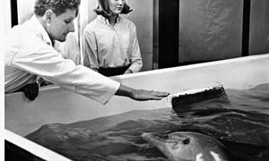
Notes:
John Lilly was another researcher at the lab - In the 1960s a small selection of neuroscientists like John Lilly were licensed to research LSD by the American government, convinced that the drug had medicinal qualities that could be used to treat mental-health patients. As part of this research, the drug was sometimes injected into animals and Lilly had been using it on his dolphins since 1964, curious about the effect it would have on them. Much to Lilly's annoyance, nothing happened. Despite his various attempts to get the dolphins to respond to the drug, it didn't seem to have any effect on them, remembers Howe. "Different species react to different pharmaceuticals in different ways," explains the vet, Andy Williamson. "A tranquilliser made for horses might induce a state of excitement in a dog. Playing with pharmaceuticals is a tricky business to say the least."

Slide 4
Notes:
Howe’s job was to see if dolphins can be taught to speak. The lab was designed to allow dolphin and human to live together in close proximity, as it could be flooded so that Peter could come in close contact. Howe reasoned that if she could live with a dolphin around the clock, nurturing its interest in making human-like sounds, like a mother teaching a child to speak, they’d have more success. "Maybe it was because I was living so close to the lab. It just seemed so simple. Why let the water get in the way?" she says. "So I said to John Lilly: 'I want to plaster everything and fill this place with water. I want to live here.'"
The radical nature of Howe's idea appealed to Lilly and he went for it. She began completely waterproofing the upper floors of the lab, so that she could actually flood the indoor rooms and an outdoor balcony with a couple of feet of water. This would allow a dolphin to live comfortably in the building with her for three months.
Howe selected the young male dolphin called Peter for her live-in experiment. "I chose to work with Peter because he had not had any human-like sound training and the other two had," she explains. Howe would attempt to live in isolation with him six days a week, sleeping on a makeshift bed on the elevator platform in the middle of the room and doing her paperwork on a desk suspended from the ceiling and hanging over the water. On the seventh day Peter would return to the sea pool downstairs to spend time with the two female dolphins at the lab – Pamela and Sissy.
But there was something getting in the way of the lessons. "Dolphins get sexual urges," says the vet Andy Williamson, who looked after the animals' health at Dolphin House. "I'm sure Peter had plenty of thoughts along those lines."
"Peter liked to be with me," explains Howe. "He would rub himself on my knee, or my foot, or my hand. And at first I would put him downstairs with the girls," she says. But transporting Peter downstairs proved so disruptive to the lessons that, faced with his frequent arousals, it just seemed easier for Howe to relieve his urges herself manually.
"I allowed that," she says. "I wasn't uncomfortable with it, as long as it wasn't rough. It would just become part of what was going on, like an itch – just get rid of it, scratch it and move on. And that's how it seemed to work out. It wasn't private. People could observe it."
For Howe it was a precious thing, which was always carried out with great respect. "Peter was right there and he knew that I was right there," she continues. "It wasn't sexual on my part. Sensuous perhaps. It seemed to me that it made the bond closer. Not because of the sexual activity, but because of the lack of having to keep breaking. And that's really all it was. I was there to get to know Peter. That was part of Peter."

Slide 5
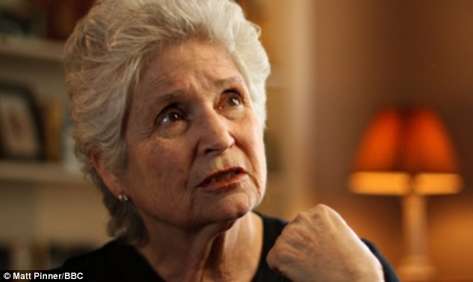
Notes:
Eventually the experiment was over, Peter wasn’t overly successful in speaking. Funding stopped and the lab was to be shut down, with Peter moved to another tank in Miami. In this new lab, with smaller tanks with little sunlight Peter quickly deteriorated. For most mammals, breathing is controlled by the autonomic nervous system (not under conscious control). Humans are unusual in that we can override this consciously (holding your breath – aquatic apes anyone?). For mammals like dolphins, who are purely aquatic, autonomic control would be disastrous, and breathing is consciously controlled. So Peter, heartbroken and alone simply refused to keep breathing and sank to the bottom of his tank.

Slide 6
Hot for Teacher
The 60s were weird
Ewwwww
Notes:
Physchology teacher: Umm yeah, that story is gross and I’m not sure it’s appropriate to tell it to students…

