Slide 1
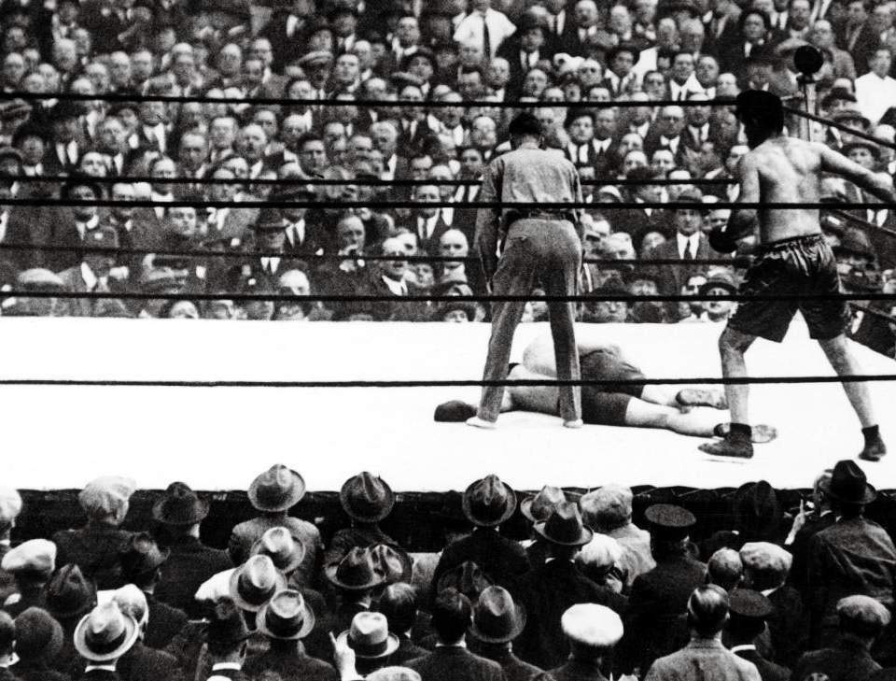
Spermists
v. Ovists
Science 10 Unit C (Biology)
Biology 30 Unit B (Reproduction)
Humanizing the Grandfathers
Notes:
References: A History of the Life Sciences, Lois Magner
A great debate that runs through the study of generation was initiated by Aristotle, who analyzed the alternative models of development known as preformation and epigenesis. Preformationist theories assume that a miniature individual exists in either the egg or the sperm and begins to grow into its adult form as the result of the proper stimulus. Epigenesis, which Aristotle favored, is based on the belief that each embryo or organism is gradually produced from an undifferentiated mass by a series of steps and stages during which new parts are added.

Slide 2
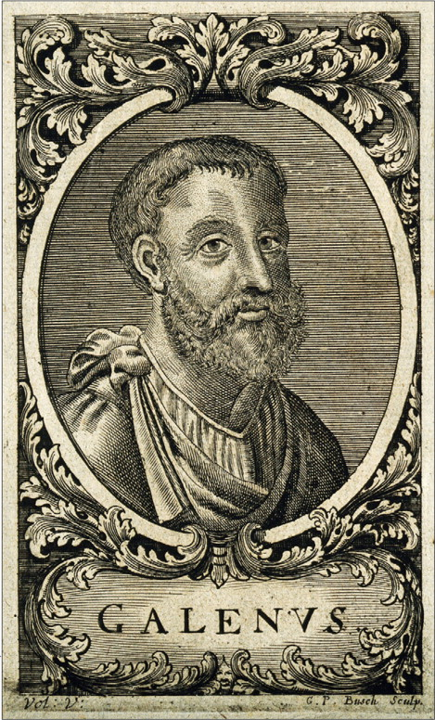
Notes:
The prolific Greek surgeon one of the few who disagreed with Aristotle’s epigenetic theory, based on his dissections. In On the Semen, Galen disputed Aristotle’s idea that the female does not form any counterpart to the male semen. The female testes (ovaries), Galen argued, secrete semen into the horns of the uterus, where male and female sexual products mix with blood furnished by the mother to form the fetus. As the fetus developed, the liver, heart, and brain appeared. After the formation of the liver, fetal life was rather like that of a plant, because it was nourished under the influence of the vegetative soul. With the formation of the heart, fetal life was like that of an animal because the heart served as the source of heat. Galen argued that the human beings are the most perfect of all animals, but man is more perfect than woman because the male has more innate heat. Indeed, it was a deficiency of innate heat that caused a fetus to become a female. As proof of this theory, Galen cited the effects of castration. By removing heat, castration caused the body of a eunuch to become more like that of a woman.

Slide 3
Notes:
There was an eruption of interest in the theory of preformationism in the mid-late 17th century, with the Ovists believing that within an egg was a tiny preformed human, with a human within that, and another within that. Conveniently this allowed for all of humanity to have been created by God in one fell swoop at the moment of creation. Clearly the semen was necessary, perhaps like the fertilizer for a seed, which requires soil (uterus) as well.

Slide 4
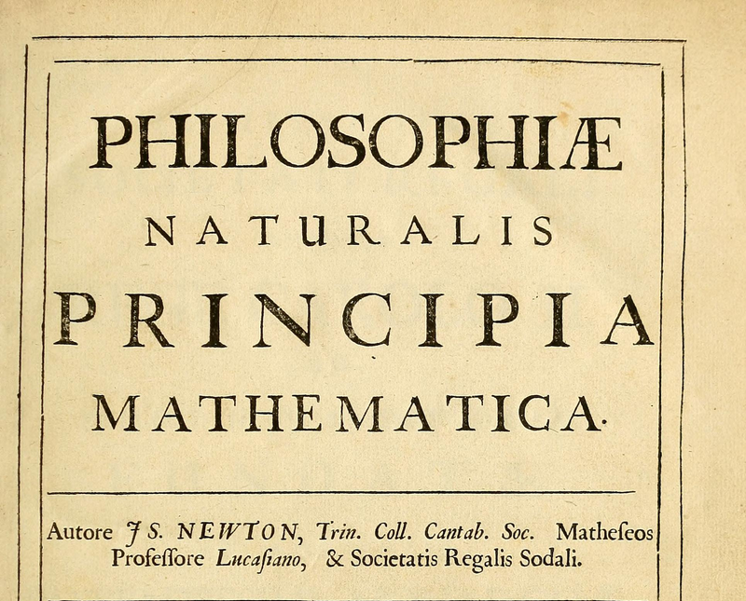
To Infinity and Beyond!
Notes:
The fact that this meant that within each woman was a series of people becoming infinitesimally small was eagerly lapped up by scientists eagerly clutching their copies of Principia. Infinitesimally small people were a validation of Newton’s calculus.

Slide 5
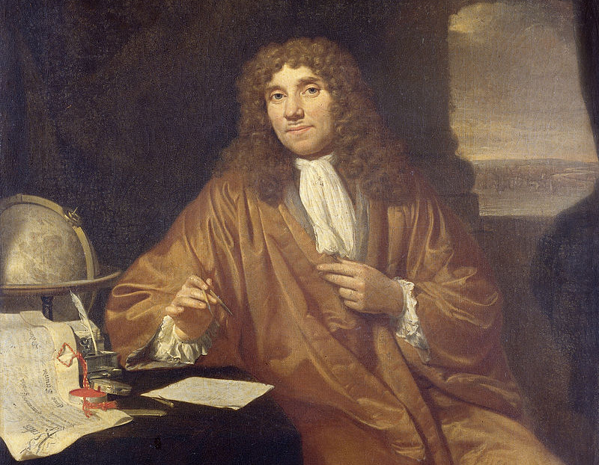
Notes:
Then of course there was this guy: Van Leeuwenhoek’s amazing microscope opened up the squiggling world of the microscopic. After whipping up a few samples to examine... (explaining that the observations of human semen were not obtained by any “sinful contrivance”, but were made with “the excess with which Nature provided me in my conjugal relations” ) He also examined the semen before “six beats of the pulse had intervened and saw...

Slide 7
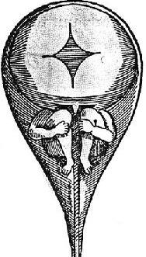
Notes:
A major problem for the spermists was a theological one – van Leewenhoek realized that since the sperm were so small that a million would not fit in a grain of sand, there must be an enormous quantity in each sample of ejaculate. Each one of these then contains an infinite number within it – the bedrooms of teenage boys are the sites of mass murder! Even the excess with which Nature provides during conjugal relations are a horrible waste. Some scientists had difficulty reconciling this theory with the idea of such a callous and wasteful God. Ultimately it was cell theory, more than 150 years later, that would eventually put the debate to rest and reveal epigenesis(embryo from an undifferentiated egg) as the mechanism.

Slide 8
Spermists v. Ovists:
- Stories help to reveal the humanity of our scientists.
- They often didn’t get it right, and that’s ok

